Slide 1

Privacy-Preserving Cryptocurrency Transactions using Encrypted Smart Contracts
CSA5116-CRYPTOGRAPHY AND ITS IMPACT ON NETWORK SECURITY
GUIDED BY:
DR.E.ANBALAGAN
PRESENTED BY;
KANMANI L(192511414)
VARSHA S(192511358)

Slide 2
INTRODUCTION
Cryptocurrency enables decentralized digital transactions through blockchain technology.
Public blockchains can expose sensitive transaction details, creating privacy concerns.
Encryption protects transaction data before it is stored on the blockchain.
Encrypted smart contracts help process transactions without exposing sensitive information.
SHA-256 hashing ensures transaction integrity and detects tampering.
This project combines cryptography and blockchain to provide confidential, secure, and verifiable cryptocurrency transactions.

Slide 3
OBJECTIVES
To protect cryptocurrency transaction data through encryption before blockchain storage.
To securely manage cryptographic keys and restrict access to authorized users.
To verify transaction integrity using SHA-256 hashing.
To securely process and store encrypted transactions using blockchain and smart contracts.
To enable authorized users to verify and securely decrypt their transaction data.

Slide 4
LITERATURE REVIEW
Year | Research Focus | Approach | Limitation | Gap Addressed by Our Project
2026 | Privacy-preserving and verifiable transactions | Cryptographic protection with smart-contract verification | Focused on vehicular energy trading | Applies privacy-preserving transactions to cryptocurrency
2025 | Privacy-preserving smart contracts | Cryptographic protocols for secure blockchain transactions | Complex cryptographic implementation | Provides a practical encryption-based approach
2025 | Privacy-preserving blockchain | Zero-knowledge proofs for private transactions | Computationally intensive proof generation | Uses encryption and hashing as a practical alternative
2025 | Accountable privacy-preserving blockchain | Blockchain and smart contracts for decentralized privacy | Focused on intelligent transportation | Applies privacy mechanisms to cryptocurrency transactions
2025 | Blockchain transaction security and privacy | Ethereum smart contracts for secure transaction processing | Focused on healthcare applications | Adapts encrypted smart-contract processing to cryptocurrency

Slide 5
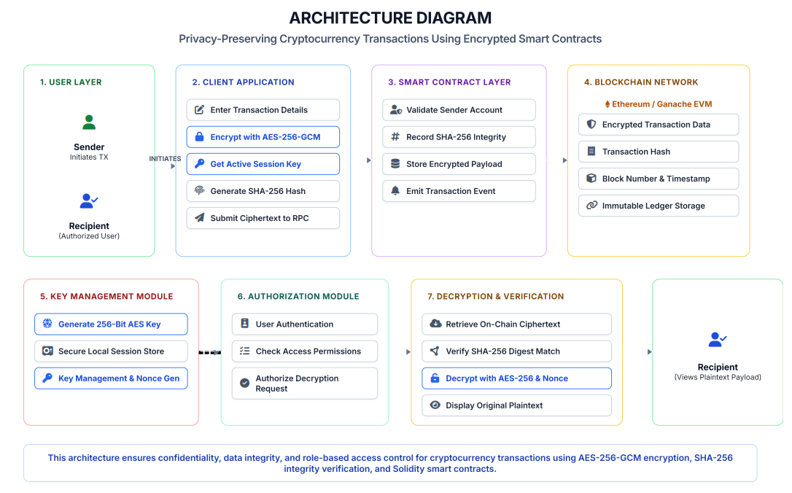
ARCHITECTURE

Slide 6
METHODOLOGY
01 | Transaction Creation
User enters the cryptocurrency transaction details through the application.
03|Hash Generation
A SHA-256 hash is generated to ensure transaction integrity.
04| Smart Contract Processing
The encrypted transaction and hash are submitted to a Solidity smart contract.
05| Blockchain Storage & Verification
The encrypted data is stored on the blockchain and later verified using its hash.
06| Authorization & Decryption
Authorized users can access and decrypt the verified transaction data.
02 | Transaction Encryption
Sensitive transaction data is encrypted before being submitted to the blockchain.
Notes:
Transaction Encryption

Slide 7

MODULES
MODULE 1: Secure Transaction Encryption & Key Management
MODULE 2:Blockchain-Based Encrypted Transaction Processing

Slide 8
Module 1:Secure Transaction Encryption & Key Management
User creates a wallet using a public–private key pair.
Cryptocurrency transaction details are entered through the application.
Sensitive transaction data is encrypted before blockchain submission.
Cryptographic keys are securely generated and managed for authorized access.
A SHA-256 hash is generated to support transaction integrity verification.
Only the encrypted transaction data is forwarded to the blockchain processing layer.
This module ensures transaction confidentiality and secure key management.

Slide 9
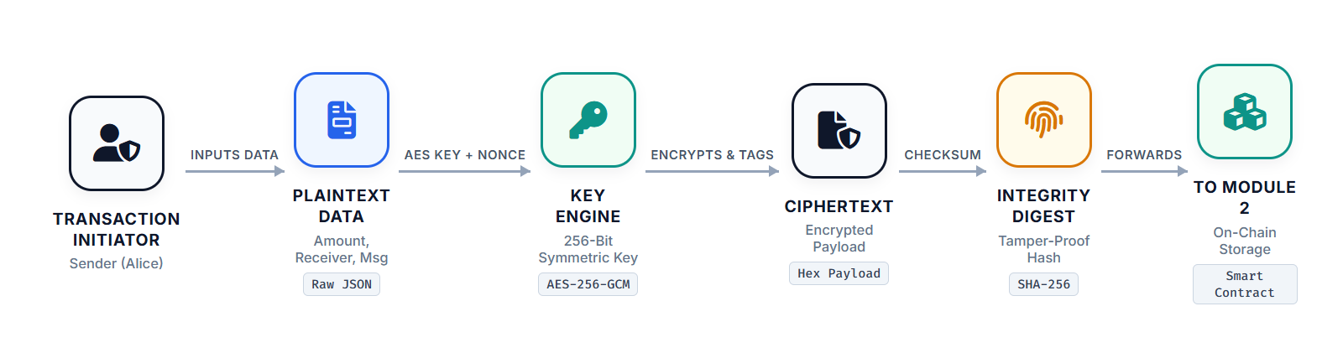
Notes:
v

Slide 10
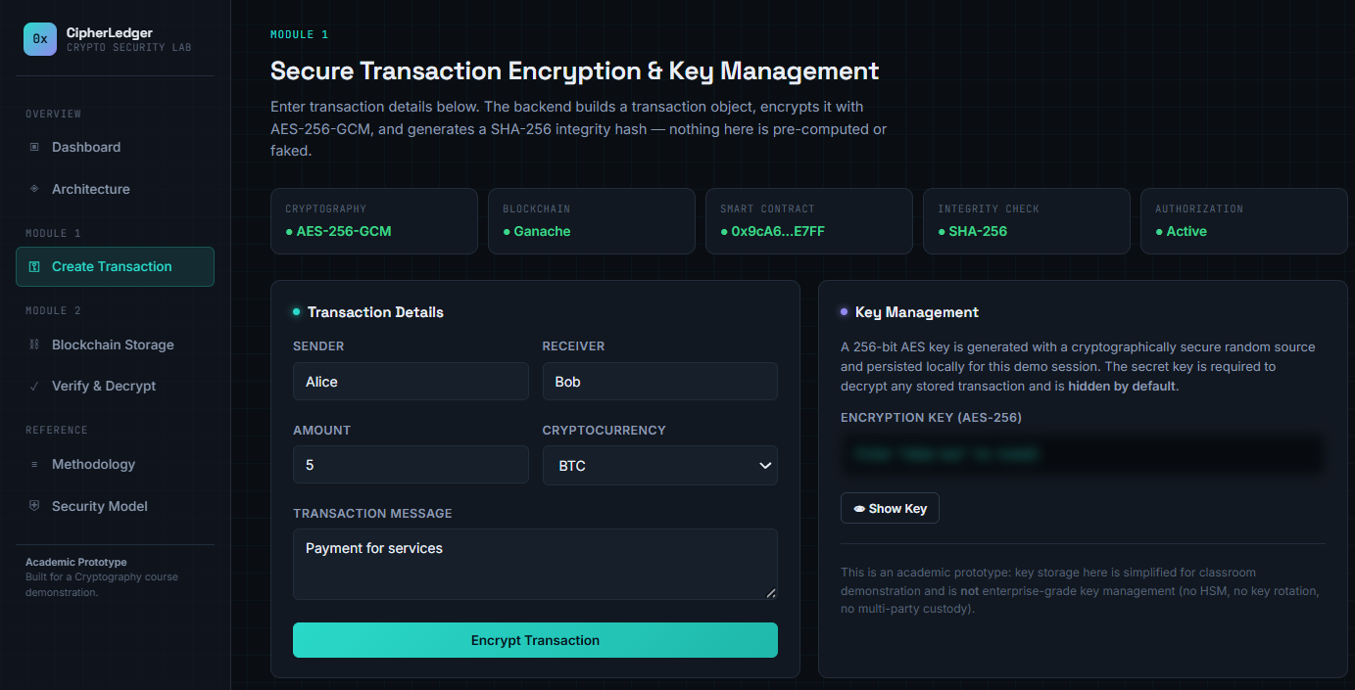
MODULE 1 IMPLEMENTATION

Slide 11
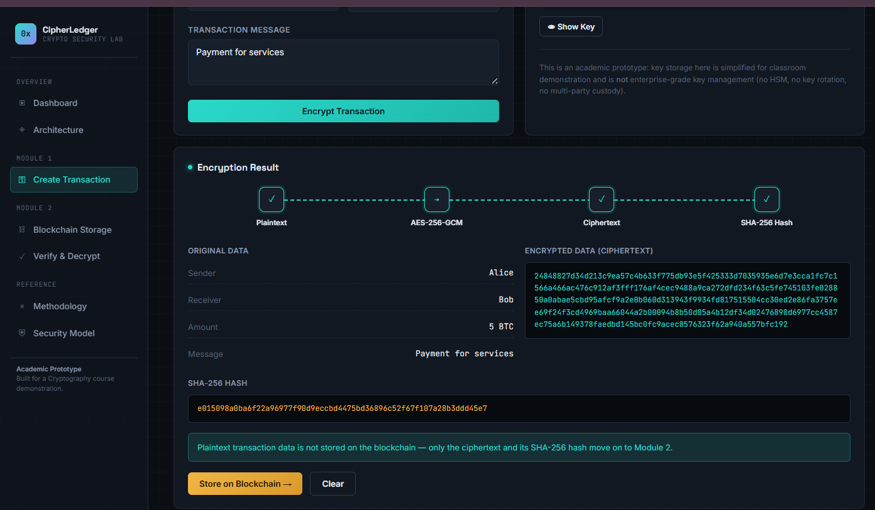

Slide 12
Module 2:Blockchain-Based Encrypted Transaction Processing
Encrypted transaction data is submitted to a Solidity smart contract, which manages and records the encrypted information.
Ciphertext and SHA-256 hash are stored on the Ganache/Ethereum blockchain for secure and tamper-resistant storage.
Retrieved transaction data is verified using SHA-256 hash comparison to ensure integrity.
User authorization is validated before access to transaction data is provided.
Authorized users can securely decrypt and retrieve the original transaction information.
Ensures secure storage, integrity verification, and controlled access to encrypted transactions.

Slide 13
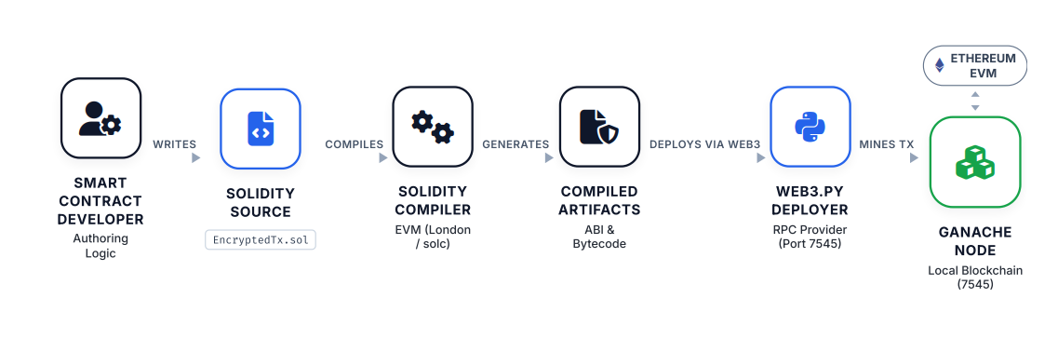

Slide 14
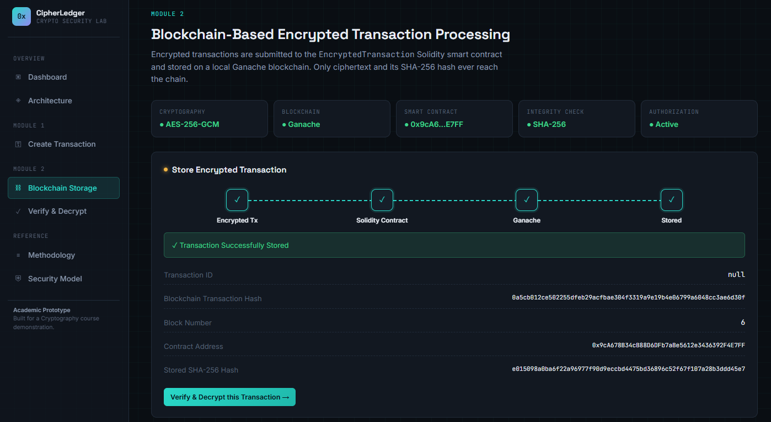
MODULE 2 IMPLEMENTATION

Slide 15
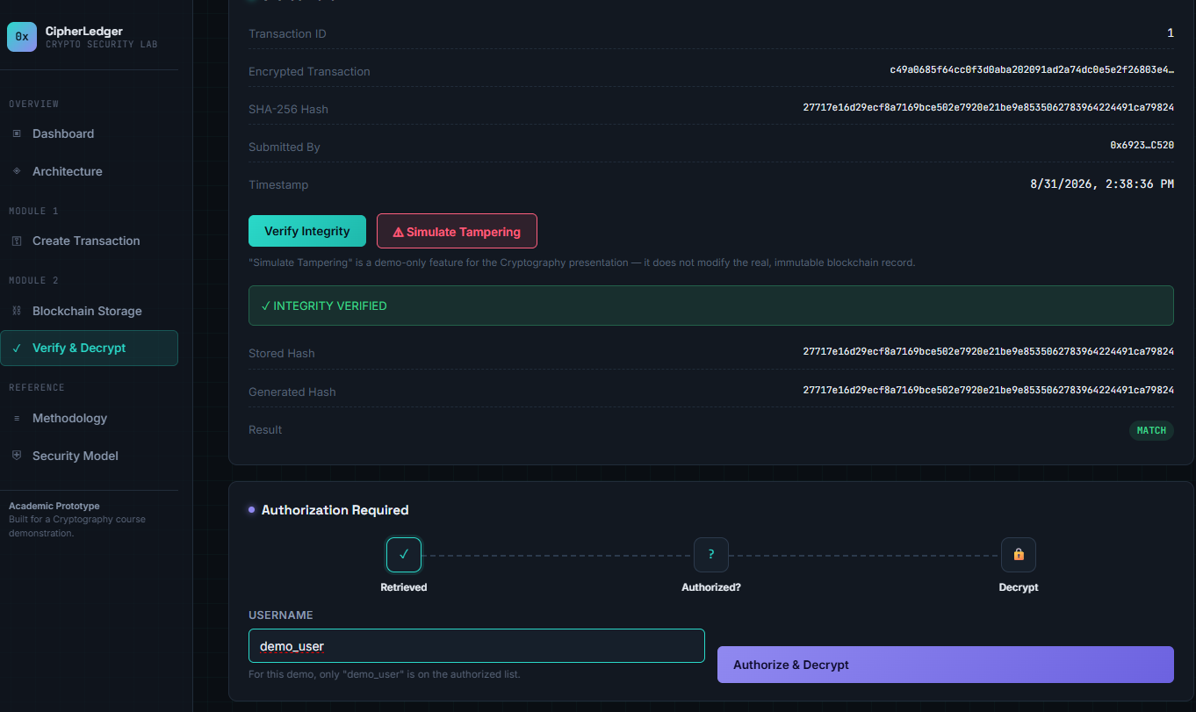
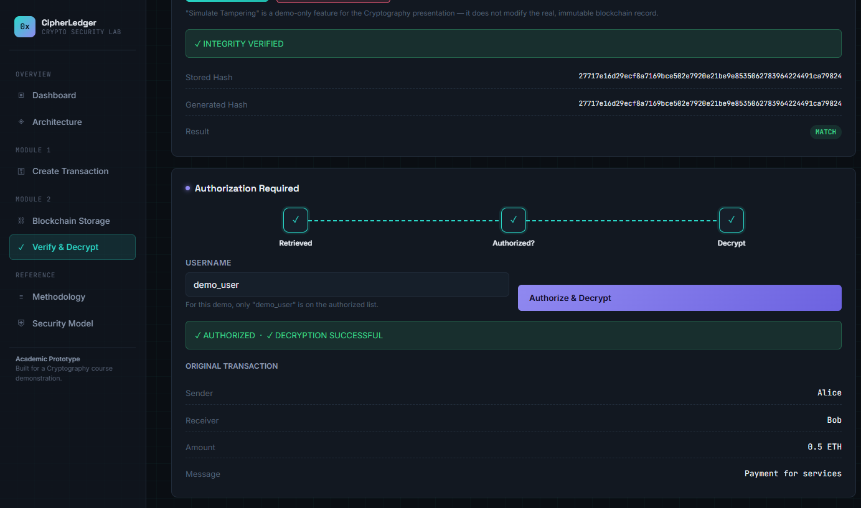

Slide 16
RESULTS & DISCUSSION
Transaction data is encrypted before blockchain storage, protecting sensitive information from unauthorized exposure.
The smart contract successfully manages encrypted transaction records on the blockchain.
SHA-256 hash verification helps detect unauthorized modification of stored transaction data.
Authorization controls restrict transaction access to legitimate users.
Authorized users can retrieve and decrypt their verified transaction information.
The proposed system improves confidentiality, integrity, and secure access for cryptocurrency transactions.

Slide 17
CHALLENGES & LIMITATIONS
Secure generation and management of cryptographic keys is essential to prevent unauthorized access.
Encryption, decryption, and blockchain operations may introduce additional processing overhead.
Increasing transaction volume can lead to higher blockchain processing time and storage requirements.
Smart contracts require careful design to ensure secure and reliable transaction processing.
Loss of cryptographic keys may prevent users from recovering encrypted transaction data.
The prototype is currently implemented and tested in a controlled/local blockchain environment.

Slide 18
FUTURE SCOPE
Integration of advanced privacy-preserving cryptographic techniques for stronger transaction confidentiality.
Deployment on public blockchain networks instead of a local blockchain environment.
Implementation of hardware-based secure key storage for improved key protection.
Addition of multi-factor or biometric authentication for secure transaction access.
Optimization of encryption and blockchain operations to improve system performance and scalability.
Extension of the system to support secure cross-chain cryptocurrency transactions.

Slide 19
CONCLUSION
The project successfully demonstrates privacy-preserving cryptocurrency transactions using encrypted smart contracts.
Secure encryption and key management protect sensitive transaction data.
Encrypted smart contracts enable confidential transaction processing.
Blockchain validation and storage maintain data integrity and trust.
Authorized decryption provides controlled access to transaction information.
The system enhances privacy while preserving decentralization and security.

Slide 20
REFERENCES
Chang, Y., Luan, T.H., Zheng, J., Li, Y. and Su, Z., 2026. PriVET: Privacy-Preserving and Verifiable Vehicular Energy Trading via Smart Contracts. IEEE Internet of Things Journal.
Prabaharan, G., Bharath, E., Subramanian, S., Kaviyaraj, R., Grace Shalini, T. and Pandiaraj, S., 2025. Privacy-Preserving and Secure Smart Contracts: Cryptographic Protocols for Blockchain Transactions. In Quantum Protocols in Blockchain Security (pp. 325-345). Singapore: Springer Nature Singapore.
Park, K., Das, A.K. and Park, Y., 2025. BAPS-DITS: Blockchain-enabled accountable privacy-preserving scheme for decentralized intelligent transportation systems. IEEE Transactions on Intelligent Transportation Systems, 26(5), pp.6749-6763.
Al-Rasheed, A., Ali, H., Khan, R. and Saeed, A., 2025. Blockchain and smart contracts: An effective approach for the transaction security & privacy in electronic medical records. Computers, Materials & Continua, 85(2), pp.3419-3436.

Slide 21
THANKYOU

